Slide 1


AI Gateway Fund
Investment Opportunity
Daniel Woodford, Principal | Kristine Jefferson, Partner
www.MissionBayCP.com

Slide 2
Disclaimer
This Investment Summary has been prepared solely for, and is being delivered on a confidential basis to, persons considering a possible business relationship with the Sponsor (defined herein). This Presentation is for informational purposes only and does not constitute an offer to sell, a solicitation of an offer to buy, or a recommendation to purchase any equity, debt or other financial instrument of the Sponsor or an affiliated company. No offer of securities shall be made except by means of a private placement memorandum meeting the requirements of the Securities Act of 1933, as amended, and applicable regulations of jurisdiction in which such an offer may be made. Any reproduction of this Investment Summary, in whole or in part, or the disclosure of its contents, without the prior written consent of the Sponsor, is prohibited.
By accepting this Investment Summary, each participant agrees: (i) to maintain the confidentiality of all information that is contained in this Investment Summary and not already in the public domain and (ii) to use this Investment Summary for the sole purpose of evaluating a business relationship with the Sponsor.
Forward-Looking Statements
This Investment Summary includes “forward looking statements” within the meaning of the “safe harbor” provisions of the United States Private Securities Litigation Reform Act of 1995. Forward-looking statements may be identified by the use of words such as “forecast”, “intend”, “seek”, “target”, anticipate”, “believe”, “expect”, “estimate”, “plan”, “outlook” and “project” and other similar expressions that predict or indicate future events or trends or that are not statements of historical matters. Such forward-looking statements include estimated financial information.
Such statements with respect to revenues, earnings, performance, strategies, prospects and other aspects of the business of the Company and are based on current expectations that are subject to known and unknown risks and uncertainties, which could cause actual results or outcomes to differ materially from expectations expressed or implied by such forward looking statements. These factors include, but are not limited to: (1) The inability of the Company to secure sufficient financing on favorable terms to acquire and operate the targeted properties; (ii) the possibility that the Company may be adversely affected by other economic, business and or competitive factors; (iii) an unexpected and unforeseeable event or events that adversely affect projections due the economic climate, weather events or events that uniquely affect acquired properties, including but not limited to litigation, latent building issues, or infrastructure issues; and (iv) other risks and uncertainties indicated from time to time in the final private placement memorandum prepared by the Company, including those under “Risk Factors” therein, and other certain other documents attached to and incorporated in a private placement memorandum for the Company.

Slide 3
Disclaimer Cont.
You are cautioned not to place undue reliance upon any forward-looking statements, which speak only as of the date made. The Company undertakes no commitment to update or revise the forward-looking statements whether as a result of new information, future events or otherwise. Anyone using the Investment Summary does so at their own risk and no responsibility is accepted for any losses which may result from such use directly or indirectly. Recipients should carry out their own due diligence in connection with the assumptions contained herein. Although the Company may from time to time voluntarily update its prior forward-looking statements it disclaims any commitment to do so whether as a result of new information, future events, changes in assumption or otherwise except as required by securities laws.
The financial and operating projections contained in this Investment Summary represent certain estimates as of the date hereof. The Company’s accountant has not examined, reviewed or compiled the projections and accordingly expresses no opinion or assurance that the projections contained herein will accurately reflect the Company’s results of operation or financial condition. The projections are presented in non-GAAP format. Assumptions and estimates underlying prospective financial information are inherently uncertain and are subject to a wide variety of significant business, economic and competitive risks and uncertainties that could cause the actual results to differ materially from those contained in prospective financial information. Accordingly, there can be no assurance the prospective results are indicative of the future performance of the Company or that actual results will not be materially different from the projections as presented. Inclusion of the prospective financial information in this Investment Summary should not be regarded as a representation by any person that the projections contained herein are indicative of future results or will be achieved. These variation variations could materially affect the ability to make payments with respect to any of its outstanding and or future debt and service obligations.”
Industry and Market Data
Unless otherwise noted, the forecasted industry and market data contained in the assumptions for the projections are based upon the Company management’s estimates and industry and market publications and surveys. The information from industry and market publications has been obtained from sources believed to be reliable, but there can be no assurance as to the accuracy or completeness of the included information. The Company has not independently verified any of the data from third-party sources, nor has it ascertained the underlying economic assumptions relied upon therein. While such information is believed to be reliable for purposes used herein, none of the Company, their respective affiliates, not their respective directors, officers, employees, member, partners, shareholder or agents many any representation or warranty with respect to such information.

Slide 4


Table of Contents
1
3
Position Held
Executive Summary
2
Preferred Equity Terms
Profit Structure
Strengths, Risks, and Mitigates
Culpeper AI Gateway Acquisition Strategy
Market Insights
Property Strengths/Risk Mitigating Factors
Exit Strategy
Biography’s
MBCP Track Record
Key Highlights
Pro Rata Guide Why we like Preferred Equity

Slide 5

1
Executive Summary

Slide 6
Executive Summary
The Overview
AI Gateway Fund – Datacenter Land Development
Investing in Risk mitigated Preferred Equity opportunities
Projects will be taken through the Datacenter Land Entitlement Process then assigned to a large Datacenter developer for sale
24 - 36 months projected hold period
Provides cashflow throughout the hold period with a lucrative profit share provision
Two initial properties are identified

Slide 7
AI Gateway Opportunity Fund
Investment
Terms
Total Raise: $2,000,000
Minimum Investment- 50K
Projected Annual Return- 35%+
Term: 24- 36 months
Structured as Preferred Equity with lucrative profit share provisions

Slide 8

2
Preferred Return Terms
7% Pref paid Monthly
10% Pref Accrued until sale
5% Profit Split

Slide 9
Why We Like Preferred Equity
Key Highlights
Returns Pref (Preferred) Equity is a safer and more reliable alternative to investing as a Limited Partner as the Pref Equity has a superior position to the GP/LP Equity.
Steady Rate of Return Pref Equity has a more reliable and stable cash flow compared to LP Equity and is ideal for investors that want a consistent cash flow.
Position in Capital Stack Pref Equity is paid back before common equity.

Slide 10
Position Held
Debt
Pref Equity*
AI Gateway Fund
LP/GP Equity

Slide 11
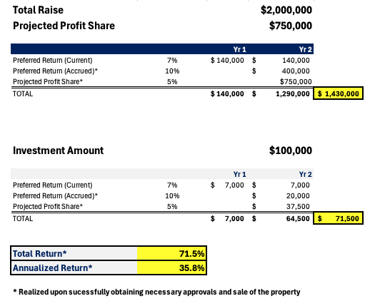

Investor Returns

Slide 12
Strengths, Risks, and Mitigates
Funds will be escrowed within the Development budget to ensure the monthly Current pay obligation is met for up to a two-year term.
Pref Reserve
AI Gateway investors will be the first in the equity stack to be paid out
Paid First
Sale is estimated to generate adequate funds to fully repay the Preferred Equity investment with 5% pro-rata profit share
Exit Strategies

Slide 13
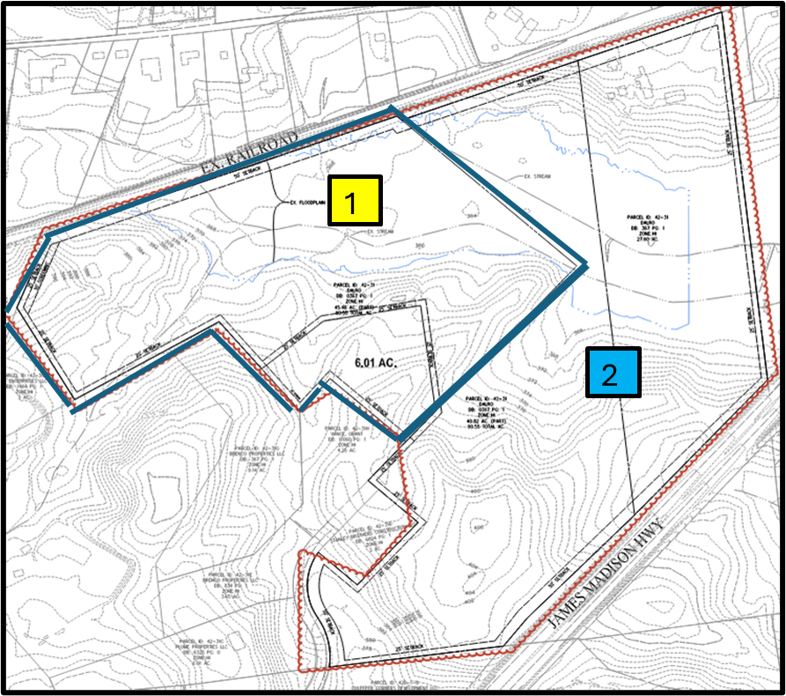

Project 1: Culpeper AI Gateway
1
Culpeper Site 1
Acquired – May 2024
Currently in Site Plan Design Execution
Small scale approval received – July 2024
Full scale approval received – Feb 2025
Culpeper Site 2
Under Contract – Aug 2024
Target of opportunity to acquire 68-acre parcel
Due Diligence ended – Nov 2024
Closing anticipated – Oct 2026
Zoned Heavy Industrial
Allows for Data Center Execution
2

Slide 14
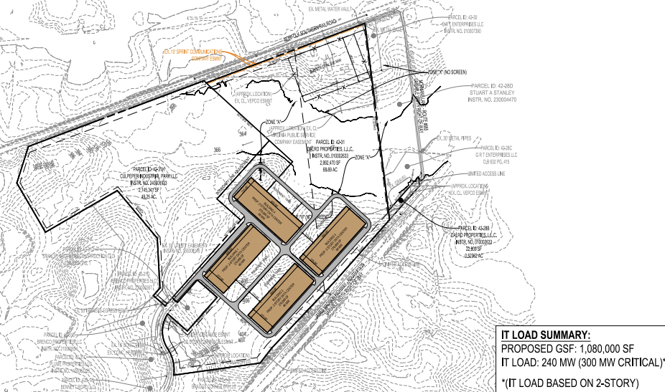
Culpeper AI Gateway
Leverages Culpeper 1
Desirable 300 MW site
Permitted Use Zoning

Slide 15

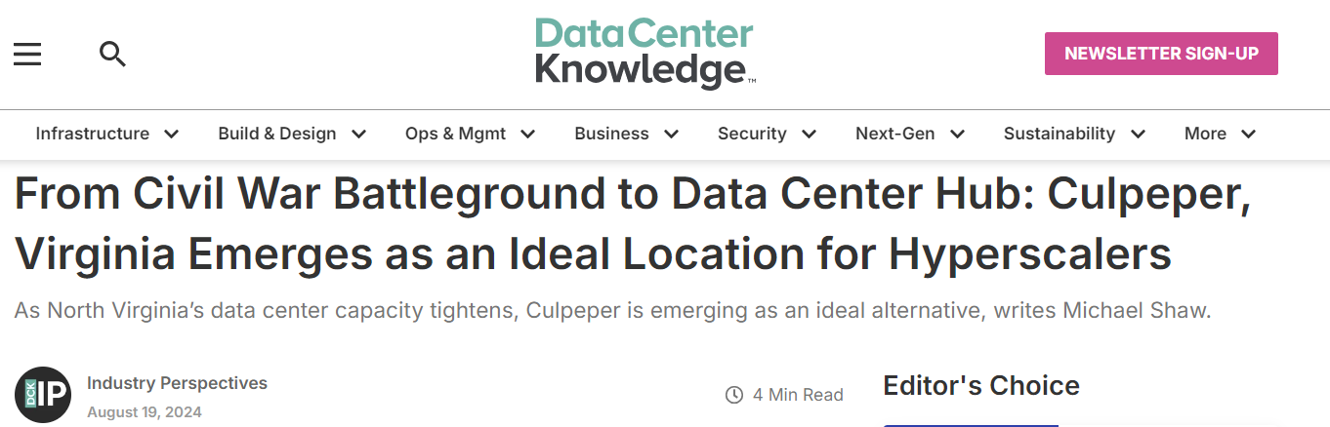

Slide 16
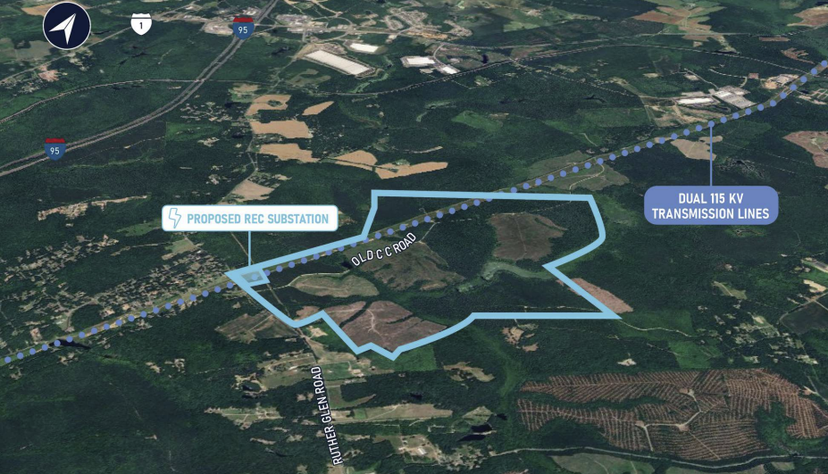
Project 2: Old CC AI Gateway
1
Culpeper Site 1
Acquired – May 2024
Currently in Site Plan Design Execution
Small scale approval received – July 2024
Expected full scale approval – Feb 2025
Culpeper Site 2
Under Contract – Aug 2024
Target of opportunity to acquire 68-acre parcel
Due Diligence ends – Nov 2024
Closing anticipated – Oct 2026
Zoned Heavy Industrial
Allows for Data Center Execution
2

Slide 17
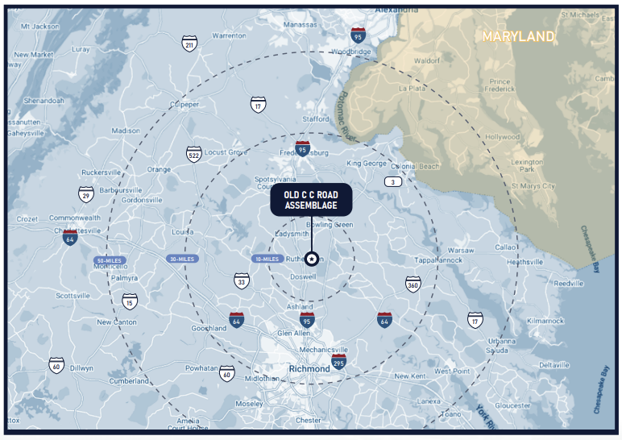
Old CC Investment Highlights
Old CC Assemblage
658 Acres of vacant Land located in Caroline County, which is one of the region’s most promising growth corridors
This area has already attracted significant investment with major hyperscalers like AWS
Old CC presents an opportunity to develop large hyperscale datacenter campuses directly between Fredericksburg and Richmond VA
The Old CC Assemblage is located partially in the Carmel Church Growth Area and just outside of the Planned Innovation Research Tech (PIRT) zone.
This property has conveyed 10 acres to Rappahannock Electric Corp for a future substation

Slide 18
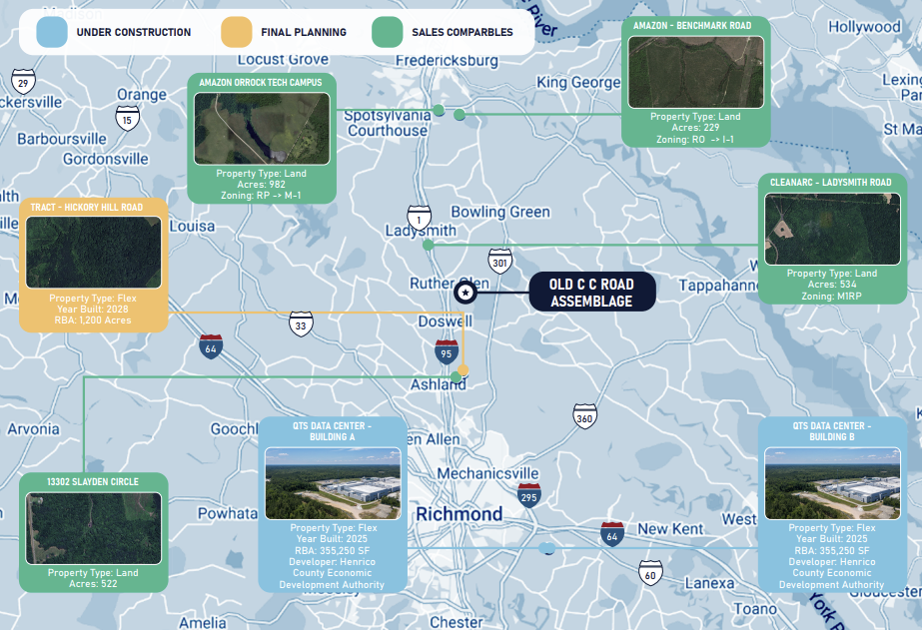
Old CC Current Market
1
Culpeper Site 1
Acquired – May 2024
Currently in Site Plan Design Execution
Small scale approval received – July 2024
Expected full scale approval – Feb 2025
Culpeper Site 2
Under Contract – Aug 2024
Target of opportunity to acquire 68-acre parcel
Due Diligence ends – Nov 2024
Closing anticipated – Oct 2026
Zoned Heavy Industrial
Allows for Data Center Execution
2

Slide 19
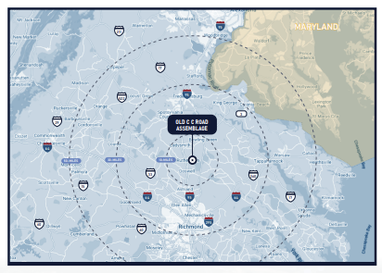
Old CC Assemblage
Old CC Timelines
Projected under contract - May 2025
Rezoning Activities – May 2025 – April 2025
Zoning Approval May 2026
Sale to End User - Dec 2026
Contract Terms:
Purchase at $52K an Acre
Sell ~$75K an Acre
Potential Profit: ~$20M

Slide 20
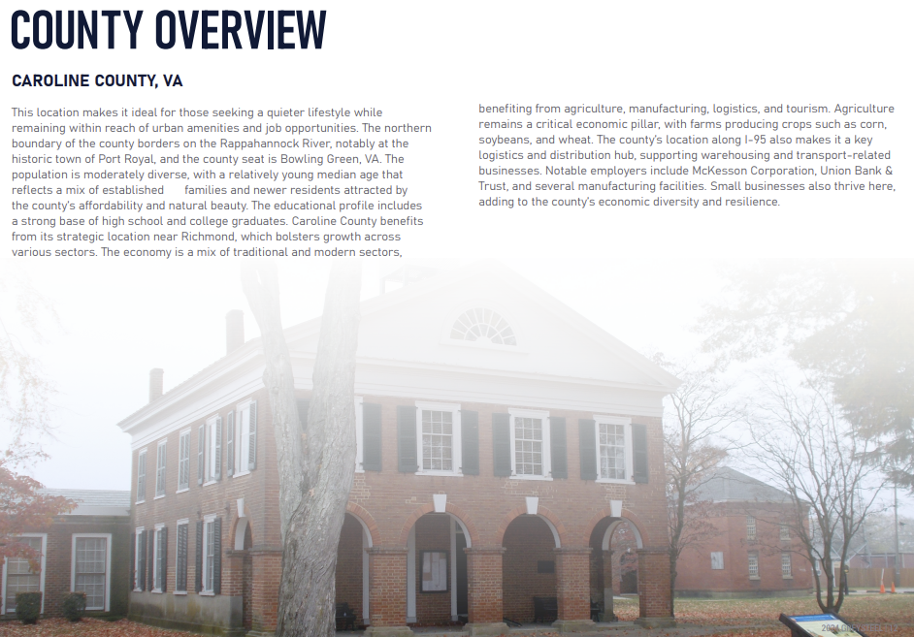
Old CC Assemblage
Old CC Timelines
Projected under contract - May 2025
Rezoning Activities – May 2025 – April 2025
Zoning Approval May 2026
Sale to End User - Dec 2026
Contract Terms:
Purchase at $52K an Acre
Sell ~$75K an Acre
Potential Profit: ~$20M

Slide 21
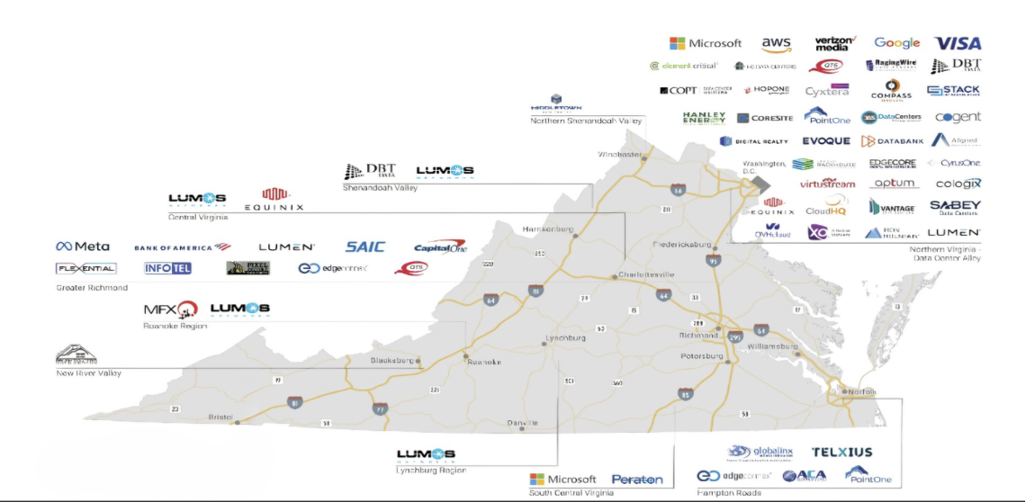
VA Market Insight
VA hosts the largest data center market in the world
35% of the world’s Hyperscalers
50% of the nation’s data centers reside in VA
Culpeper is quickly becoming the new hub in VA

Slide 22
Exit From Initial Investment
The Development team plans to get all approvals and then begin to market to End Users
Possible End Users: Amazon, Microsoft, Google, META

Slide 23
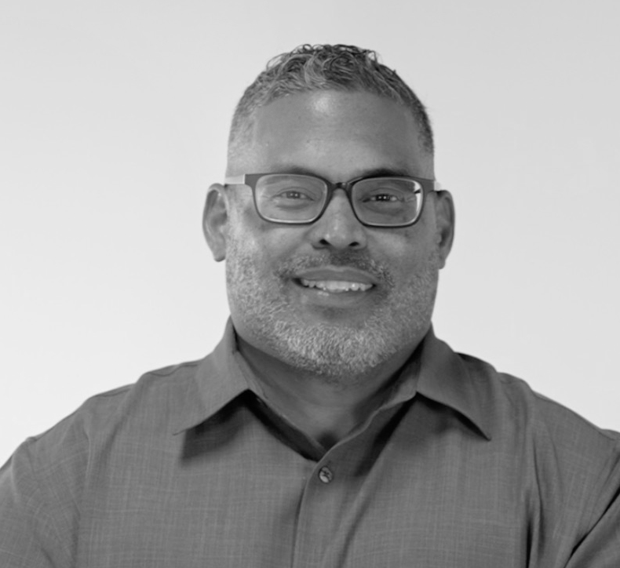

Who We Are
Daniel Woodford
Kristine Jefferson
CEO, Mission Bay Capital Partners, LLC
Daniel Woodford is a Mission Bay Capital Partners Co-Founder with over 13+ years of experience accentuating the multifamily investing and real estate syndication landscapes. Known for helping others attain their unique versions of investment success, Daniel has strong expertise regarding aggressive ROI integrations, private investor networking, and the art of fostering healthy financial independence. He also enjoys utilizing his industry acumen to position investors for sustainable wealth trajectories while ensuring they feel confident as they navigate the arena of alternative investing.
COO, Mission Bay Capital Partners, LLC
Co-Founding Mission Bay Capital Partners on the foundation of integrity, Kristine Jefferson is a respected multifamily investor and entrepreneur renowned for helping investors achieve new levels of financial literacy, growth, and independence. As the COO, Kristine brings with her an extensive 14+ year background involving the intricacies of real estate syndication, ROI optimization, and cultivating advanced pipeline/team efficiencies. Even more, she enjoys leveraging that asset class dynamicity to not only propel organizational initiatives forward, but to deliver aspiring investors what they value the most – time, energy & wealth.

Slide 24
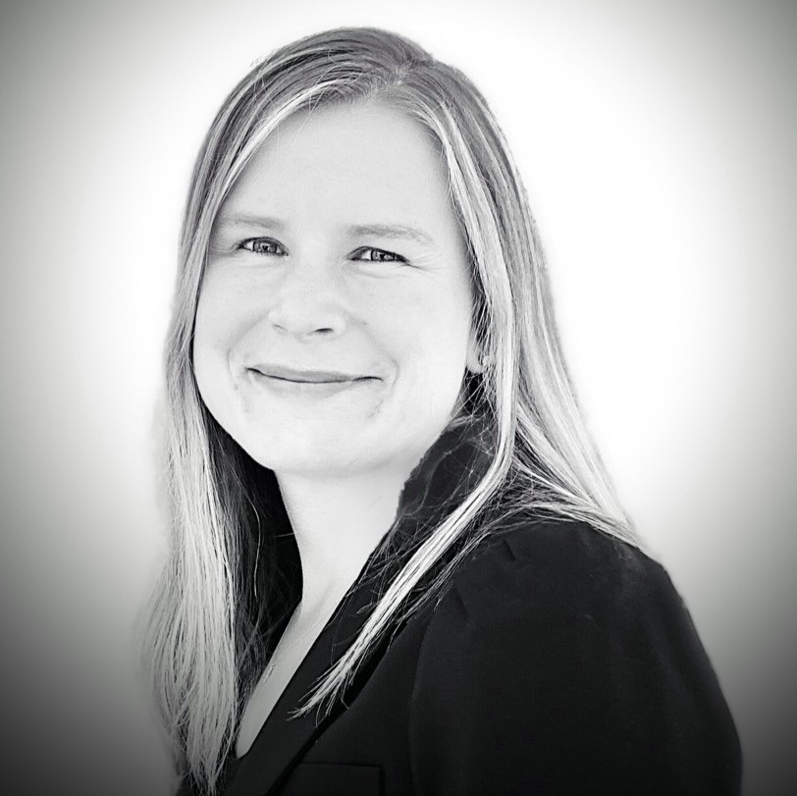
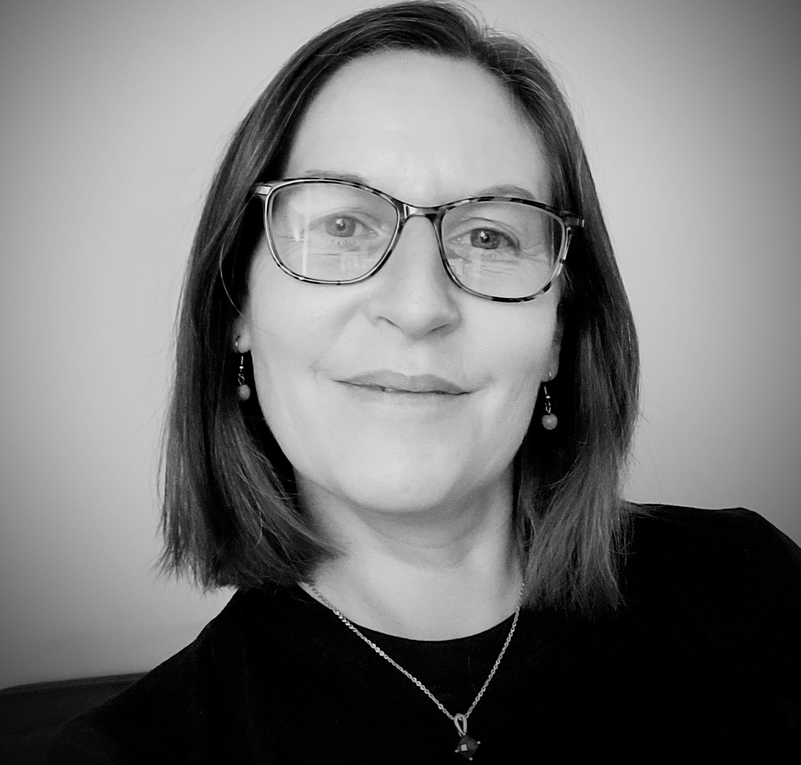
Who We Are
Karolina Dimario
Lindsay Stough
Acquisition Manager, Mission Bay Capital Partners, LLC
Karolina Dimario is a multifamily investor, syndicator, and Acquisition Manager of Mission Bay Capital Partners. Karolina started her real estate career in 2012 and is currently invested in 429 units. Analytical in nature she enjoys underwriting multifamily properties and finding ways to improve the efficiency of the operations to maximize investor returns. Karolina holds a Bachelor’s Degree in Business Economics.
Executive Administrative Assistant, Mission Bay Capital Partners, LLC
Lindsay joined Mission Bay Capital Partners in February 2021 bringing with her over 25 years of administrative knowledge and experience. She is responsible for the overall task management of the office and provides administrative support to various departments including finance, investor relations, and marketing. She helps coordinate and prepare for general partner and investor meetings, monthly reporting, and office support where needed. Lindsay’s contribution towards the betterment of Mission Bay Capital Partners and her continued dedication and commitment to her position has made her a pillar to Mission Bay Capital Partners.

Slide 25

Track Record
Property | Location | Units | Date Acquired | Price Acquired | Date Sold | Price Sold | Cash on Cash | IRR | ARR
Towne Oaks East | Tyler, TX | 104 | January 2018 | $4.5M | June 2019 | $6.61M | 8.50% | 16.50% | 22.50%
Hidden Village | Mesa, AZ | 84 | June 2019 | $7.4M | May 2021 | $13.15M | 7.00% | 28.00% | 33.00%
Castaways | Warner Robins, GA | 211 | June 2017 | $10.6M | August 2021 | $19.1M | 8.00% | 16.60% | 14.00%
Towne Oaks | Tyler, TX | 90 | August 2018 | $6.075M | October 2021 | $19.1M | 8.00% | 26.00% | 33.00%
Villages at Wake Forest | Winston Salem, NC | 294 | April 2018 | $20.1M | October 2022 | $43M | 7.50% | 23.3% | 27.60%
Abbey Lake | Thomasville, GA | 152 | January 2019 | $8.6M | November 2022 | $14.8M | 7.82% | 17.00% | 28.00%

Slide 26
QUESTIONS

